Slide 1



Class 1: Introduction to Business Intelligence
Unit I: Fundamentals of Business Intelligence
Sebastián Muñoz-Herrera, PhD.
Héctor Hormazábal
Notes:
Hi, Welcome everyone to Class 1 of Business Intelligence. My name is Sebastián Muñoz-Herrera, and I'll be guiding you through this course over the coming months.
Before we dive in, let me give you a quick picture of what this course is about. Business Intelligence, or BI, is one of the most in-demand skill sets in today's data-driven world. Whether you end up working in finance, logistics, healthcare, or retail, understanding how to turn raw data into decisions is a superpower.
This first class is your starting point. We'll define what BI actually means, explore why it matters, look at real-world cases here in Chile, and finish with a hands-on Python session. By the end of today, you'll have a clear mental model of what BI is — and you'll have written your first lines of data code.
But before we begin, I'd love a brief introduction from each of you. Please share your name, your areas of interest within Industrial Engineering, and something you enjoy doing in your free time.
Im Sebastián Muñoz Herrera, I am Industrial Engineer by profession, I have a Master Degree in Industrial Engineering too, and I hold a PhD in Complex Systems Engineering. My interest is in Operations Research and Machine Learning methods. I enjoy my time with my family, play soccer and write research articles.
Who wants to go first?

Slide 2
Schedule
UNIT I: Fundamentals of Business Intelligence (Classes 1–3)
UNIT II: Data Preparation and Predictive Models (Classes 4–7)
UNIT III: Advanced Analytics and Machine Learning Models (Classes 8–12)
UNIT IV: Ethical Communication for Decision Making (Classes 13–16)
Muñoz-Herrera and Hormazábal Class 1: Introduction to Business Intelligence Unit 1: Fundamentals of Business Intelligence
Notes:
Let me walk you through the four units of the course so you know exactly where we're headed.
Unit I, which starts today, covers the Fundamentals of Business Intelligence — what it is, how it works, where data comes from.
Unit II moves into Data Preparation and Predictive Models — this is where you'll get your hands dirty cleaning and modeling data.
Unit III is the exciting one: Advanced Analytics and Machine Learning.
And Unit IV brings it all together with a focus on communicating insights ethically to support decision-making.
Notice how the course is structured like a pipeline: first you understand BI, then you prepare data, then you build models, and finally you communicate results. Each unit builds on the previous one — so keeping up with the pace really matters.
If at any point you feel lost, reach out early. We'd rather help you now than rescue you at the final exam.

Slide 3



Evaluation
Midterm week (2)
Class Assignments
Final Exam
70%
30%
70%
30%
Muñoz-Herrera and Hormazábal Class 1: Introduction to Business Intelligence Unit 1: Fundamentals of Business Intelligence
Notes:
Let's talk about how you'll be evaluated, because I know this is the slide everyone actually pays attention to.
Your final grade has two components. Thirty percent comes from Class Assignments — these are the practical exercises you'll do throughout the semester. They're designed to be doable if you keep up with the material, so don't skip them. The remaining seventy percent comes from two midterm exams, each worth half of that. This evaluations represents the grade 70% of the total grade. The final exam (all students need to attend)
There is no final exam — the midterms ARE your final evaluation.
Here's my honest advice: the class assignments are your best friend. They keep you practicing, they build the skills you'll need for the midterms, and they're lower stakes. Students who do the assignments consistently almost always do well on the exams.
Any questions about the evaluation before we move on?

Slide 4
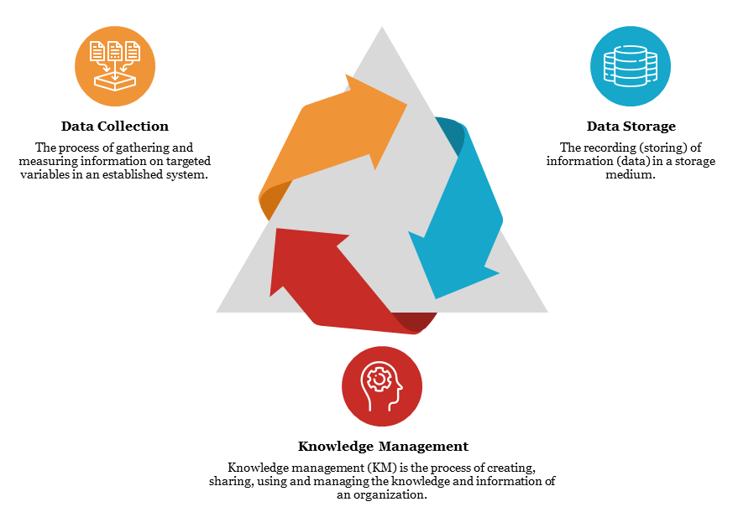
Business Intelligence – Core Concept
Business intelligence (BI) is a data-driven DSS that combines data gathering, data storage,
and knowledge management with analysis to provide input to the decision process.
Muñoz-Herrera and Hormazábal Class 1: Introduction to Business Intelligence Unit 1: Fundamentals of Business Intelligence
Notes:
Now let's get into the substance of the course. What is Business Intelligence?
What do you think Business Intelligence is? (collect some insights by students) – Collect ideas.
Here's the formal definition: BI is a data-driven Decision Support System — a DSS — that combines data gathering, data storage, and knowledge management with analysis to provide input to the decision process.
Let me unpack that. "Data-driven" means decisions are based on evidence, not gut feeling.
"Decision Support System" means BI doesn't make decisions for you — it gives you the right information at the right time so you can decide better.
And "knowledge management" means it's not just raw data — it's data that's been organized, cleaned, and made meaningful.
Think of BI like a well-organized kitchen. Raw ingredients are your data. The kitchen tools — knives, stoves, blenders — are your analytics software. The recipe is your business question. And the meal you serve is the insight that drives a decision. BI is what turns a pantry full of random ingredients into a three-course dinner.

Slide 5



Business Intelligence – Why Does BI Matter?
The problem | The BI Solution | Result
Thousands of daily routes, weather disruptions, customs delays, and fuel costs — impossible to manage manually | Real-time data from GPS, weather APIs, customs systems, and customer demand fed into predictive models | 15 % reduction in fuel costs, fewer delays, and dynamic rerouting in real time
Store managers ordering inventory by instinct, massive overstock and stockouts, no visibility across regions. | Retail Link: a BI system connecting all suppliers, stores and distribution centers in real time. Every sale, every shelf, every truck — tracked. | Inventory costs cut by 20%, suppliers got direct access to their own sales data, and Lider overtook Sears as #1 retailer in Chile
Hundreds of simultaneous chemical processes, extreme temperatures and pressures, thousands of variables changing every second — impossible for humans to monitor manuallyS | platform integrates sensor data, process historians, and real-time BI dashboards to monitor every unit, flag anomalies, and optimize throughput automatically | 5-8 % increase in refinery yield, 30% reduction in unplanned shutdowns, and real-time visibility across global operations from a single control room
Muñoz-Herrera and Hormazábal Class 1: Introduction to Business Intelligence Unit 1: Fundamentals of Business Intelligence
Notes:
Definitions are useful, but examples make things real. Let me show you three companies you might recognize — all operating in Chile — and how BI transformed their operations.
Put in the classrooom Starken, Lider and ENAP. How ENAP uses BI in their operations?
First, Starken, the logistics company. They face thousands of daily routes, weather disruptions, customs delays, fuel cost spikes — all happening at once. No human team could manually optimize all of that. By feeding real-time GPS data, weather APIs, and demand forecasts into predictive models, they achieved a 15% reduction in fuel costs and real-time rerouting.
Second, Lider. Store managers used to order inventory by instinct — the result was massive overstock in some products and empty shelves in others. Their BI system, Retail Link, connected every supplier, store, and distribution center in real time. The result? A 20% cut in inventory costs, and Lider surpassed Sears to become Chile's top retailer.
Third, ENAP, Chile's national oil company. Refining involves thousands of simultaneous chemical processes at extreme pressures and temperatures. Their BI platform monitors every unit, flags anomalies automatically, and optimizes throughput — achieving a 5–8% increase in yield and a 30% reduction in unplanned shutdowns.
Three industries, three different problems, one solution: Business Intelligence.

Slide 6
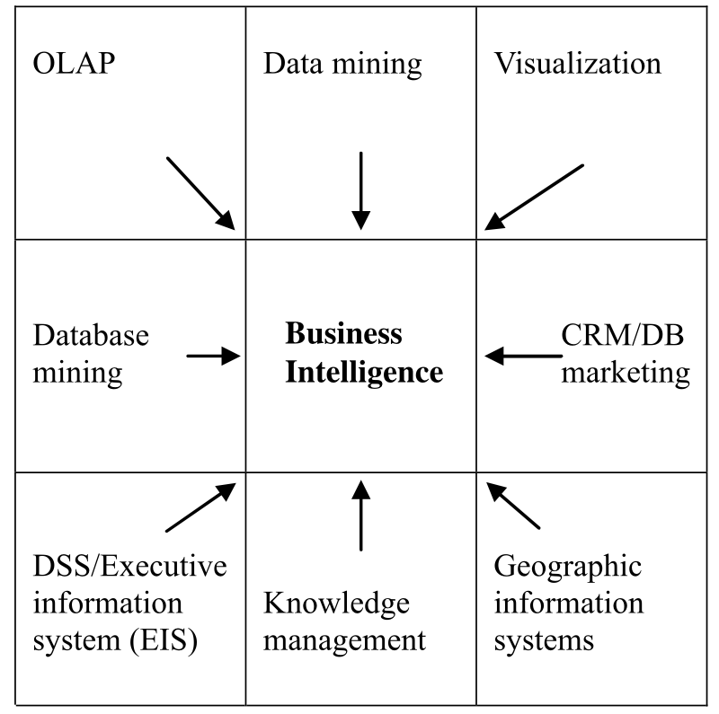

Business Intelligence – Core Concept
Business intelligence is the result of a series of innovations over the years
Muñoz-Herrera and Hormazábal Class 1: Introduction to Business Intelligence Unit 1: Fundamentals of Business Intelligence
Notes:
BI didn't appear out of nowhere. It's the result of decades of innovation, and understanding that history helps you appreciate why modern BI looks the way it does.
In the 1950s and 60s, businesses started automating basic record-keeping with early computers.
In the 1970s and 80s, Decision Support Systems emerged — software specifically designed to help managers make better decisions.
The 1990s brought data warehouses and OLAP (Online Analytical Processing) tools — ways to store and query large structured datasets.
The 2000s brought self-service BI platforms like Tableau and Power BI, making analytics accessible to non-programmers.
And now, in the 2020s, we're seeing AI-augmented BI — systems that don't just show you what happened, but tell you what to do next.
You're entering this field at one of the most exciting moments in its history.

Slide 7
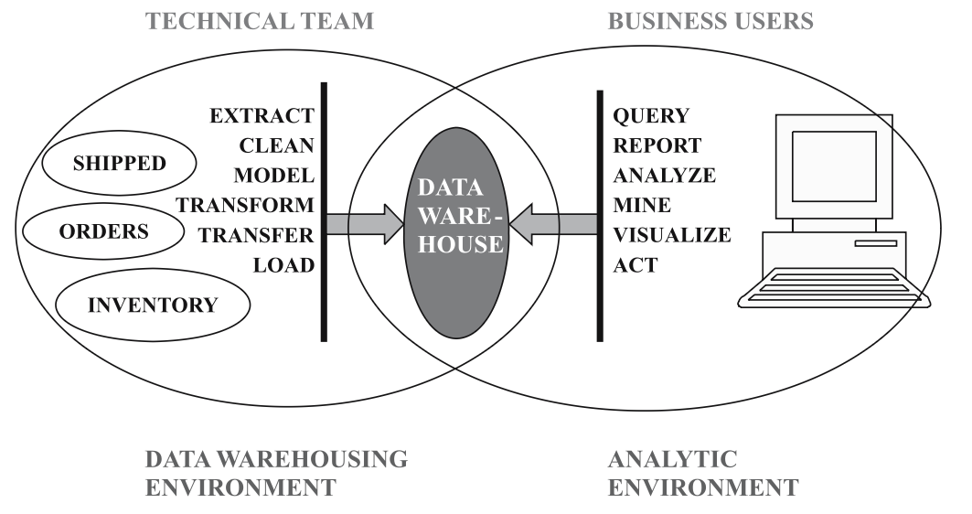
Business Intelligence – Role of Warehouse Storage
A data warehouse is a large database. It is defined as a subject oriented, integrated, time variant, non-volatile, collection of data in support of management decission processes
Muñoz-Herrera and Hormazábal Class 1: Introduction to Business Intelligence Unit 1: Fundamentals of Business Intelligence
Notes:
The heart of any BI system is the data warehouse. Let me explain what that means.
A data warehouse is a large, specially designed database. The classic definition describes it as subject-oriented, integrated, time-variant, and non-volatile. Let me break those terms down:
Subject-oriented means data is organized around business topics — customers, sales, products — not around the operational systems that generated the data.
Integrated means data from multiple sources is combined and made consistent.
Time-variant means historical data is preserved so you can track changes over time.
And non-volatile means once data enters the warehouse, it's not changed or deleted — it's a record of what happened.
Think of a data warehouse as the long-term memory of an organization.
Your operational databases — the ones running your website, processing orders, tracking inventory — those are short-term memory. The warehouse keeps everything, organized, and ready for analysis.
Without a warehouse, BI is just guesswork with extra steps.

Slide 8
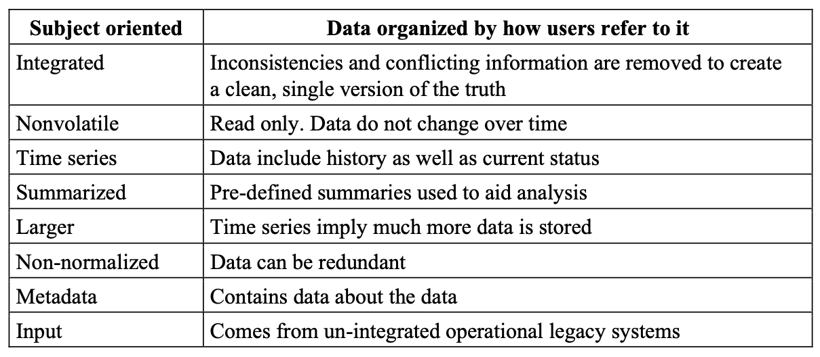
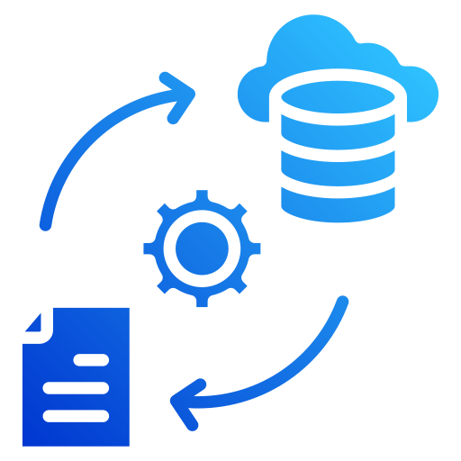
Business Intelligence – Data Warehouse Characteristics
(traditional)
***
Muñoz-Herrera and Hormazábal Class 1: Introduction to Business Intelligence Unit 1: Fundamentals of Business Intelligence

Slide 9

Business Intelligence – Data Analytics
Descriptive analytics
"What happened?" Summarizes historical data through reports and dashboards to understand past performance. The most common and foundational type of analytics.
Predictive analytics
"What will happen?" Uses statistical models and machine learning to forecast future outcomes, such as customer churn or demand forecasting.
Analytics plays a central role in Business Intelligence (BI) by transforming raw data into actionable insights that support decision-making.
Prescriptive analytics
"What should we do?" Recommends specific actions to achieve desired outcomes using optimization models and AI-driven decision tools.
Muñoz-Herrera and Hormazábal Class 1: Introduction to Business Intelligence Unit 1: Fundamentals of Business Intelligence
Notes:
One of the most important frameworks in BI is the three types of analytics. These define what questions BI can answer.
Descriptive analytics asks: "What happened?" It summarizes historical data through reports and dashboards. If you've ever looked at a monthly sales report or a website traffic dashboard, you've consumed descriptive analytics. It's the most common type — and the foundation of everything else.
Predictive analytics asks: "What will happen?" It uses statistical models and machine learning to forecast future outcomes. Customer churn prediction, demand forecasting, credit risk scoring — these are all predictive analytics. You'll learn the tools to do this in Units II and III.
Prescriptive analytics asks: "What should we do?" It goes beyond prediction to recommendation — using optimization models and AI to suggest specific actions. Think of a navigation app that doesn't just predict traffic, but tells you exactly which route to take. That's prescriptive.
As you progress through this course, you'll move from descriptive to predictive to prescriptive. Each layer is more complex — and more valuable.

Slide 10
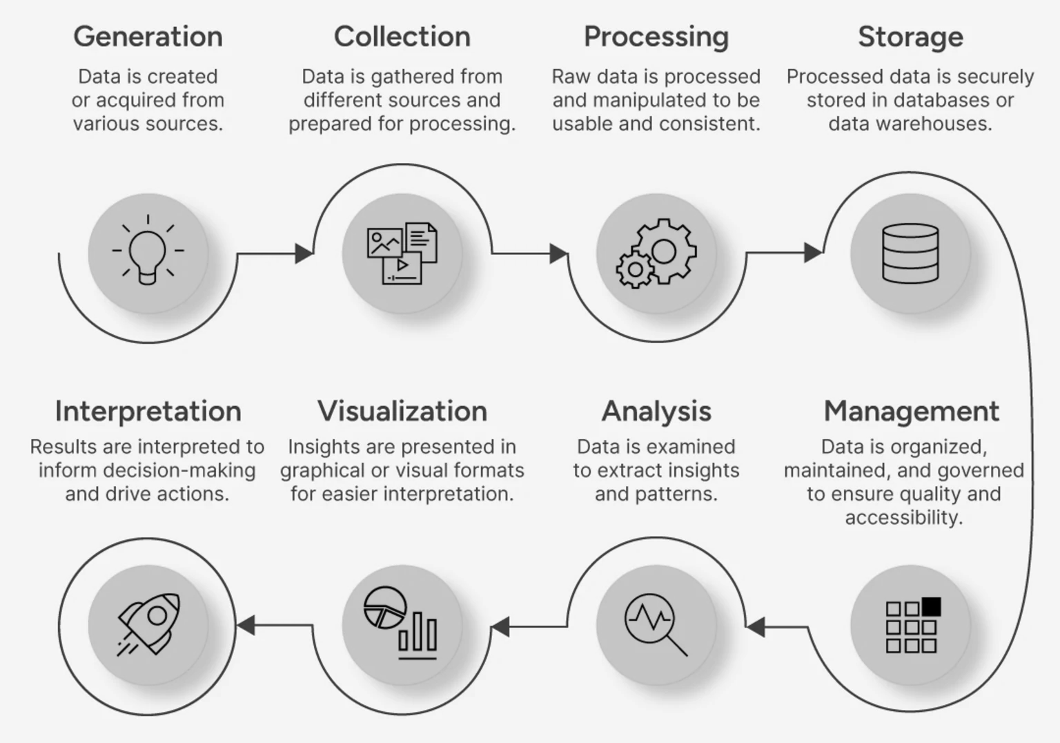
Business Intelligence – Data Cycle
Muñoz-Herrera and Hormazábal Class 1: Introduction to Business Intelligence Unit 1: Fundamentals of Business Intelligence
Notes:
Everything in BI follows a cycle. Data doesn't just appear in a dashboard — it travels a long journey before it gets there.
The data cycle typically starts with data generation — something happens in the real world: a sale, a sensor reading, a customer click. That event is captured and stored in a source system.
Then comes data collection and extraction — pulling data from those sources.
Next is transformation — cleaning, formatting, and standardizing the data so it's consistent and usable.
Then loading into a warehouse or data lake. Then analysis — applying queries, models, and algorithms.
And finally visualization and communication — turning results into charts, reports, and dashboards that humans can act on.
This cycle repeats continuously. Modern organizations generate data 24/7, and their BI systems process it in near real-time.
Understanding this cycle is crucial because problems in BI almost always trace back to a broken step in the cycle. Garbage in, garbage out — as the saying goes.

Slide 11
Business Intelligence – BI Ecosystem
Layer | What It Is | Real Examples
Data Sources | Where raw data lives — structured and unstructured | ERP systems, IoT sensors, CRM, social media, web logs, spreadsheets
ETL / ELT | Extract, Transform, Load — cleans and moves data into storage | Apache Spark, Talend, dbt, AWS Glue
Data Warehouse | Central, organized repository for historical and current data | Snowflake, Google BigQuery, Amazon Redshift, Azure Synapse
Analytics Engine | Where data gets interrogated — from SQL queries to ML models | Python, R, SAS, Databricks
Visualization Layer | Translates numbers into insight humans can act on | Power BI, Tableau, Looker, Grafana
Decision | The whole point — faster, smarter, evidence-based action | C-suite dashboards, operational alerts, automated triggers
Muñoz-Herrera and Hormazábal Class 1: Introduction to Business Intelligence Unit 1: Fundamentals of Business Intelligence

Slide 12
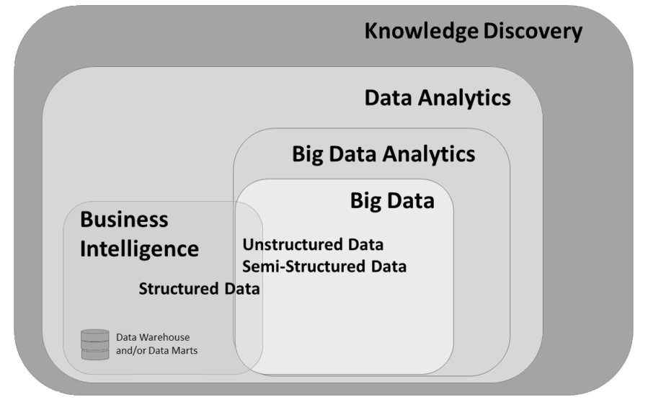
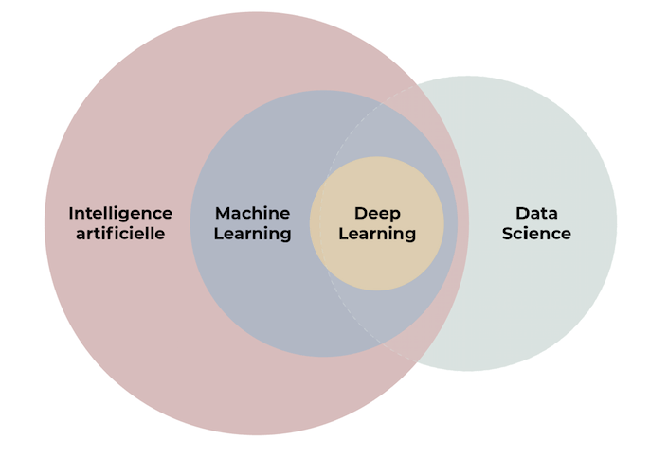
Some concepts differentiation
Muñoz-Herrera and Hormazábal Class 1: Introduction to Business Intelligence Unit 1: Fundamentals of Business Intelligence

Slide 13

Practical Section
Google Colab — First steps
Variables, lists, dictionaries, loops, functions
Load a CSV, explore it, filter it, sort it
One chart with matplotlib or seaborn — histogram or bar chart
Students modify the notebook solo: change filter, add a column, re-plot
Muñoz-Herrera and Hormazábal Class 1: Introduction to Business Intelligence Unit 1: Fundamentals of Business Intelligence

Slide 14
Class 1: Introduction to Business Intelligence
Unit I: Fundamentals of Business Intelligence
Sebastián Muñoz-Herrera, PhD.
Héctor Hormazábal

